Slide 1
CRIME-REVIEW-IN THE MONTH OF JULY 2024

Slide 2
Introduction :
The Crime Review for the Month of July 2024 dataset provides a statistical analysis of crime incidents, categorized under various major and minor heads. It tracks the number of reported cases across different crime types, including murder, property disputes, and personal vendettas, along with their comparative statistics from the previous month and the corresponding period in the previous year. The dataset contains 689 entries with 14 columns, recording crime trends and patterns over time. While the primary focus is on tracking crime rates, some columns contain missing or irrelevant data. This dataset serves as a valuable resource for understanding crime trends, aiding law enforcement agencies and policymakers in making informed decisions for crime prevention and public safety.

Slide 3
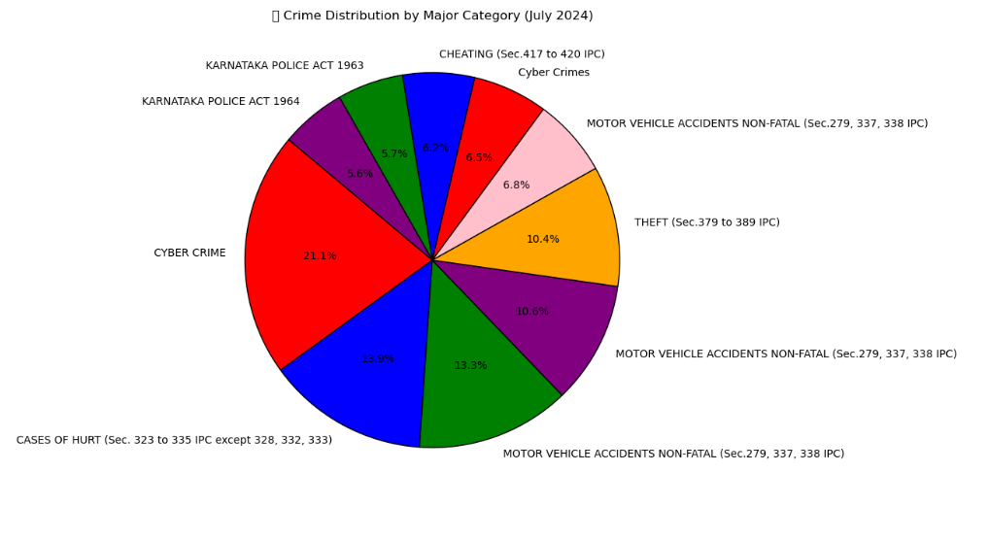
Crime Distribution by Major Category (July 2024)

Slide 4
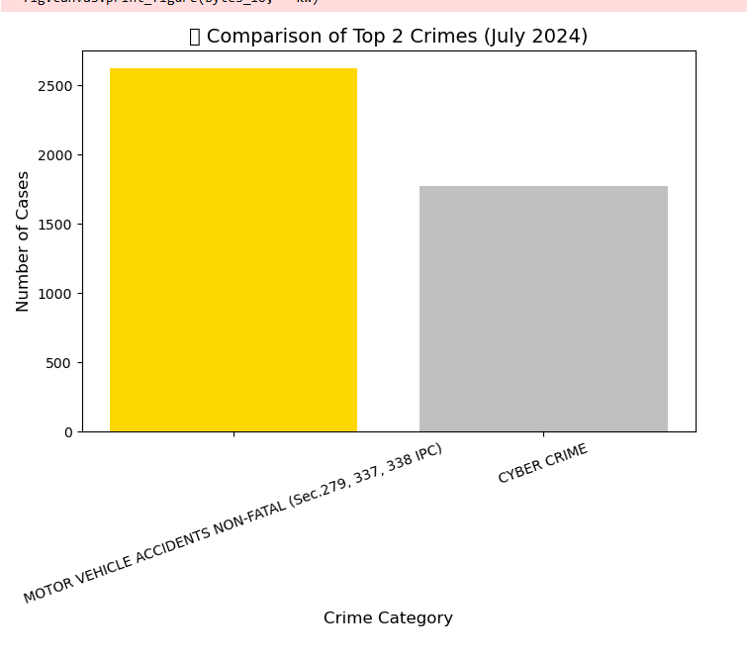
Comparison of Top 2 Crimes (July 2024):

Slide 5
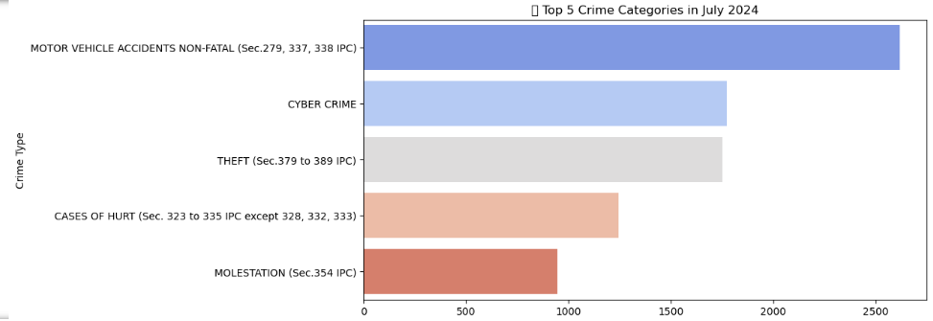
Top 5 Crime Categories in July 2024

Slide 6
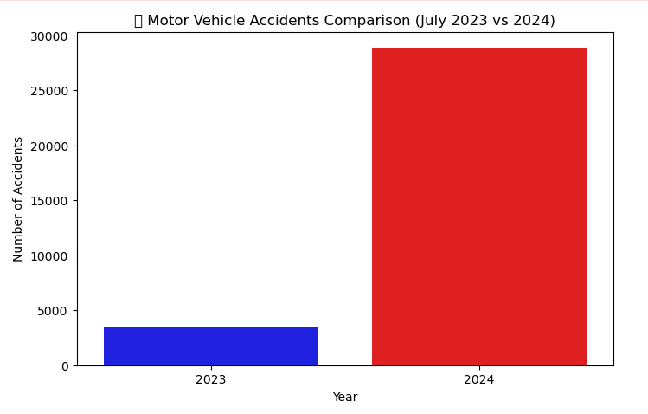
Motor Vehicle Accidents Comparison (July 2023 vs 2024):

Slide 7
Observations from Data Analysis :
The crime data analysis for July 2024 provides insights into crime trends and variations. The dataset includes 689 records with 14 columns covering different crime types and their occurrence across months. The data is mostly complete, with minimal missing values and no duplicates.
Among the top crime categories, murder (Sec. 302/303 IPC) had one of the highest occurrences. Property-related crimes and personal vendetta cases were also significant. Cyber crimes were reported but at a lower rate than traditional crimes like theft and vehicle-related offenses.
Visual analysis showed that violent crimes were the most common, with murder and property crimes having high variations in occurrences. Cyber crimes had fewer fluctuations, and the overall crime data had a right-skewed distribution, meaning a few crime types were very frequent while others were rare. Bar charts confirmed that murder, theft, and vehicle-related offenses were the most reported crimes, while cyber and white-collar crimes had lower counts.

